Slide 1
ARITHMETICAL REASONING

Slide 2
Venn diagram based problems

Slide 3
Venn diagram based problems:
Venn, a British mathematician, developed what are called Venn diagrams mainly to illustrate the principles of Set Theory and certain operations on sets.
This type of diagram is extensively used in scientific and engineering presentations, in theoretical Mathematics, in Computer applications and in Statistics.
In general, Venn Diagrams are logical diagrams, in which various items and their relationships are represented by circles or other types of diagrams.

Slide 4
In these questions, you will be presented with different classes or groups of familiar objects and you will be asked to identify their mutual relationships.
This requires a logical understanding and careful observation of diagrams.
The following Applications will explain the different types of questions under this category.

Slide 5
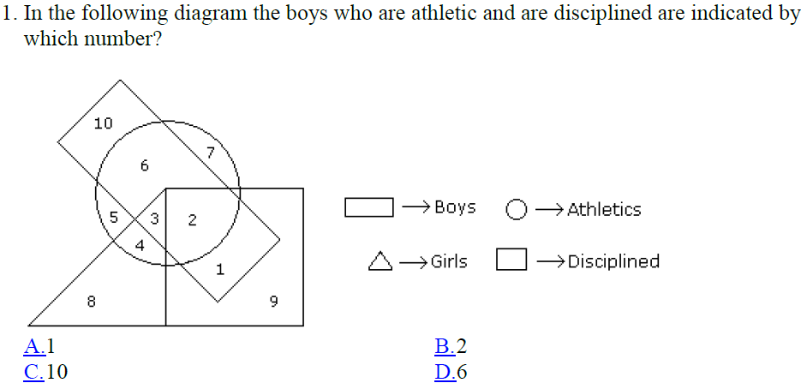
Logical Venn diagrams:

Slide 6
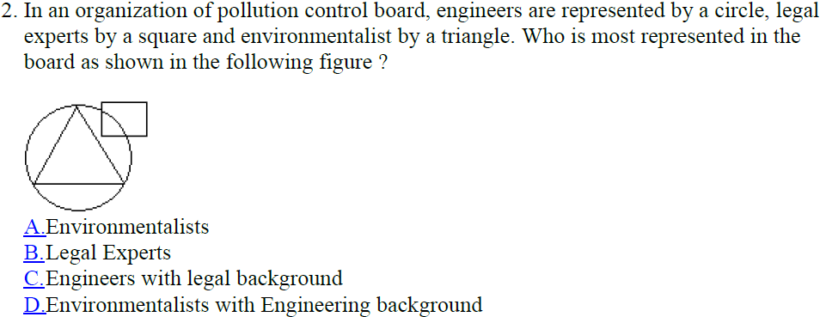

Slide 7
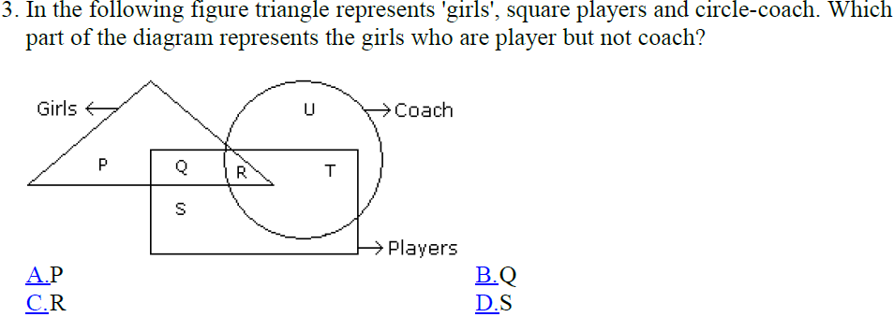

Slide 8
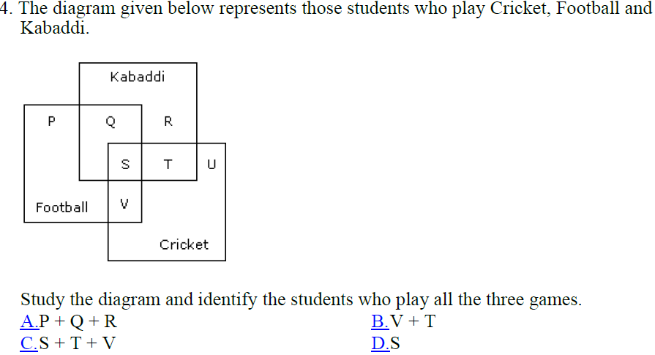

Slide 9
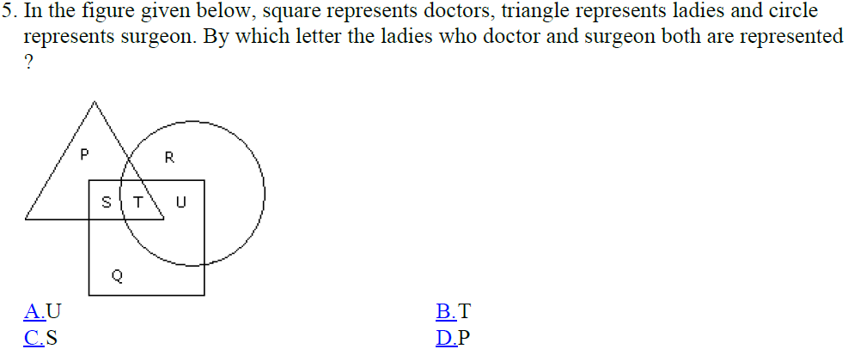

Slide 10
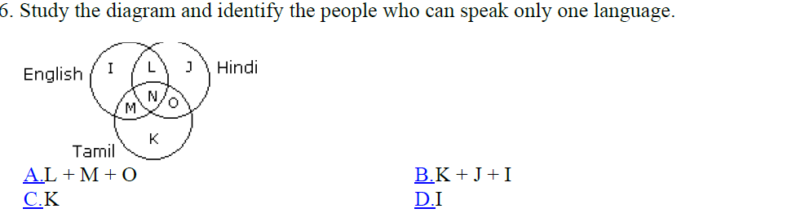
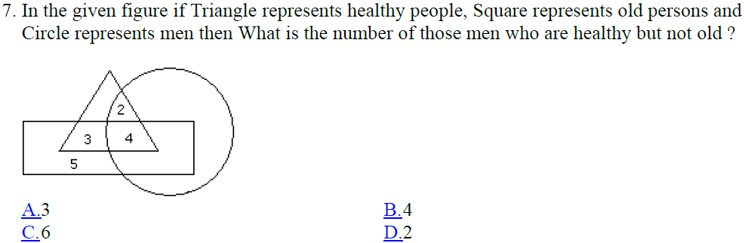

Slide 11
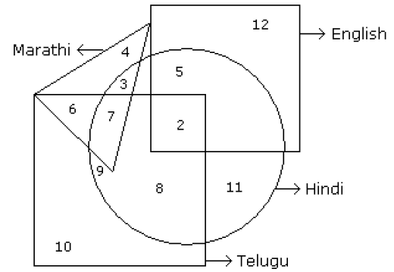

Answer from the following figure:

Slide 12





Slide 13
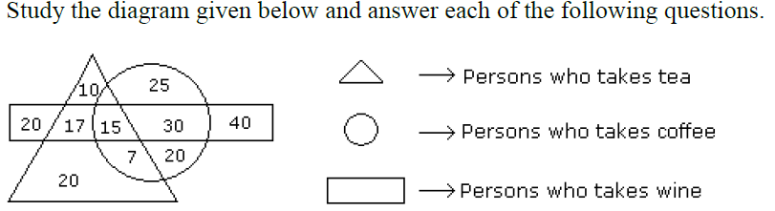
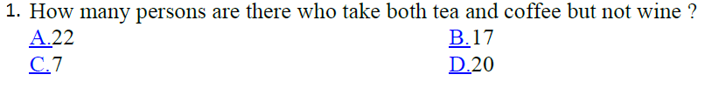
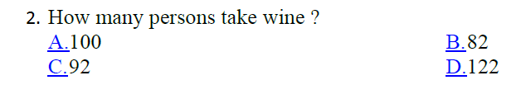

Slide 14
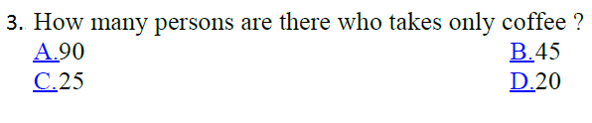


Slide 15

Set theory

Slide 16
Practice questions

Slide 17
Q1) In a survey, it was found that 65% of the people would watch news on TV, 40% read in newspaper, 25% read newspaper and watched TV. What percentage of people neither watched TV nor read newspaper?
a) 0%
b) 5%
c) 10%
d) 20%
Ans-

Slide 18
Q2) In a class, 20 opted for Physics, 17 for Math's, 5 for both and 10 for other subjects. The class contains how many students?
a) 35
b) 42
c) 52
d) 60
Ans-

Slide 19
Q3) In a class of 50 students, 18 take Chorus, 26 take Band, and 2 take both Chorus and Band. How many students in the class are not enrolled in either Chorus or Band?
a) 12
b) 4
c) 8
d) 6
Ans-

Slide 20
Q4) In a class consisting of 100 students, 20 know English and 20 do not know Hindi and 10 know neither English nor Hindi. The number of students knowing both Hindi and English is
a) 5
b) 10
c) 15
d) 20
Ans-

Slide 21
Q5) Each student in a class of 40 plays at least one indoor game chess, carom and scrabble. 18 play chess, 20 play scrabble and 27 play carom. 7 play chess and scrabble, 12 play scrabble and carom and 4 play chess, carom and scrabble. Find the number of students who play both chess and carom.
A) 6
B) 8
C) 10
D) 12
Ans-

Slide 22
Q6) A veterinarian surveys 26 of his patrons. He discovers that 14 have dogs, 10 have cats, and 5 have fish. 4 have dogs and cats, 3 have dogs and fish, and 1 has a cat and fish. If no one has all three kinds of pets, how many patrons have none of these pets?
a) 6
b) 0
c) 5
d) 3
Ans-

Slide 23
Q7) In a survey of brand preference for toothpastes, 82% of the population (number of people covered for the survey) liked at least one of the brands I, II and III. 40% of those liked brand I, 25% liked brand II and 35% liked brand III. If 5% of those showed liking for all the three brands, then what percentage of those liked more than one of the three brands?
a) 13
b) 10
c) 8
d) 5
Ans- A

Slide 24
Q8) In a competition, a school awarded medals in different categories. 36 medals in dance, 12 medals in dramatics and 18 medals in music. If these medals went to a total of 45 persons and only 4 persons got medals in all the three categories, how many received medals in exactly two of these categories?
a) 12
b) 13
c) 14
d) 15
Ans-

